Slide 1

Unit-3 Public Key Encryption and Hash Algorithms
Information & Network Security (INS)
DU #2101CS622
Prof. Maulik D. Trivedi
Computer Engineering Department
maulik.trivedi@darshan.ac.in
9998 265 805

Slide 2

Looping
Outline
Public Key Cryptosystems with Applications
RSA algorithm
Computational aspects and Security
Diffe-Hillman Key Exchange algorithm
Cryptographic Hash Functions
Applications
Simple hash functions
Hash functions based on Cipher Block Chaining
Secure Hash Algorithm (SHA)

Slide 3



Symmetric Key Encryption
Secret key shared by sender and recipient
Secret key shared by sender and recipient
K
K
Transmitted
cipher text
Y = E(K, X)
X
X
Plaintext
input
Encryption Algorithm
(e.g. AES)
Decryption Algorithm
(reverse of encryption algorithm)
Plaintext
output

Slide 4
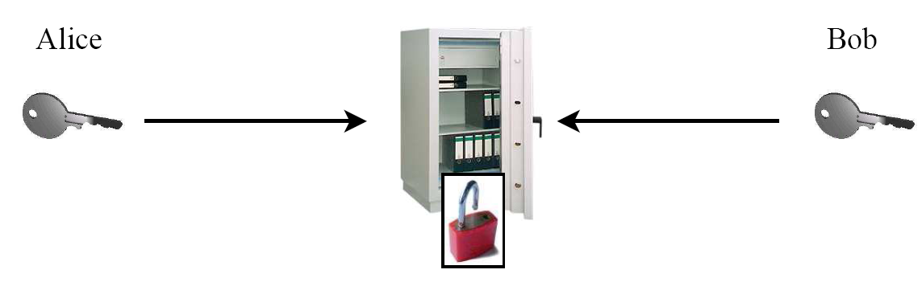
Symmetric Key Encryption example
Safe with a strong lock, only Alice and Bob have a copy of the key
Alice encrypts: locks message in the safe with her key
Bob decrypts: uses his copy of the key to open the safe

Slide 5
Asymmetric Key Encryption with Public Key
Bob’s Public key ring
The entire encrypted message serves as a confidentiality.
Joy
Ted
Mike
Alice
PU_{a}
Alice’s public key
PR_{a}
Alice’s private key
Transmitted
cipher text
Y = E(PU_{a}, X)
X
X
Plaintext
input
Plaintext
output
Encryption Algorithm
(e.g. RSA)
Decryption Algorithm
Bob
Alice

Slide 6
Asymmetric Key Encryption with Private Key
The entire encrypted message serves as a digital signature.
Alice’s Public key ring
Joy
Ted
Mike
Bob
PR_{b}
Bob’s private key
PU_{b}
Bob’s public key
Transmitted
cipher text
Y = E(PR_{b}, X)
X
X
Plaintext
input
Plaintext
output
Encryption Algorithm
(e.g. RSA)
Decryption Algorithm
Bob
Alice

Slide 7
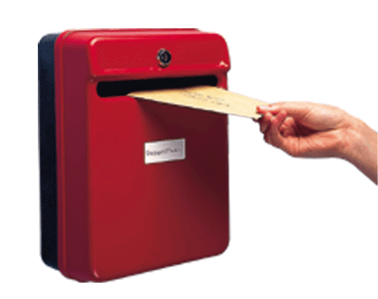

Asymmetric Key Encryption example
Use the old Mailbox principle, everyone can drop a letter but Only the owner has the correct key to open the box.
Public Key
Private Key

Slide 8
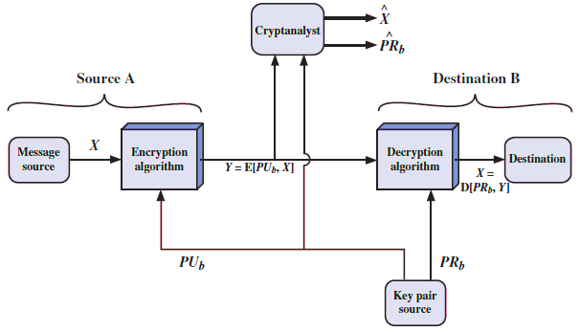
Encryption with public key: Confidentiality

Slide 9
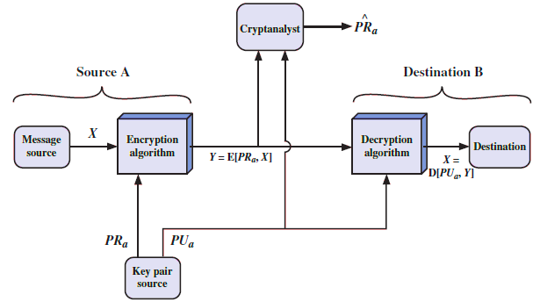
Encryption with private key: Authentication

Slide 10
Public-Key Cryptosystem: Confidentiality & Authentication
Source A
Source B
Message
source
X
Encryption
Algorithm
Y
Encryption
Algorithm
Z
Decryption
Algorithm
Y
Decryption
Algorithm
X
Message
Dest.
PUb
PRb
Key pair
source
PRa
PUa
Key pair
source
Z = E(PU_{b}, E(PR_{a}, X))
X = D(PU_{a}, D(PR_{B}, Z))

Slide 11
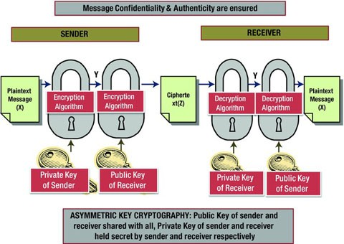
Confidentiality & Authentication

Slide 12
Applications for Public-Key Cryptosystems
Encryption/decryption:
The sender encrypts a message with the recipient’s public key.
Digital signature:
The sender “signs” a message with its private key.
Signing is achieved by a cryptographic algorithm applied to the message or to a small block of data that is a function of the message.
Key exchange:
Two sides cooperate to exchange a session key.
Several different approaches are possible, involving the private key(s) of one or both parties.

Slide 13
RSA Algorithm
RSA is a block cipher in which the Plaintext and Ciphertext are represented as integers between 0 and n-1 for some value of n.
Large messages can be broken up into a number of blocks.
Each block would then be represented by an integer.
Step-1: Generate Public key and Private key.
Step-2: Encrypt message using Public key.
Step-3: Decrypt message using Private key.

Slide 14
Step-1: Generate Public key and Private key
Select two large prime numbers: p and q
Calculate modulus : n = p * q
Calculate Euler’s totient function : φ(n) = (p-1) * (q-1)
Select e such that e is relatively prime to φ(n) and 1 < e < φ(n)
Determine d such that d * e ≡ 1 (mod φ(n))
Public key: PU = { e, n }
Private key: PR = { d, n }
Two numbers are relatively prime if they have no common factors other than 1 or (gcd(φ(n) , e)=1).

Slide 15
Step-2 and 3: Encryption and Decryption
Step-2: Encryption using Public Key:
Plaintext: M
Ciphertext: C = Me mod n
Step-3: Decryption using Private Key:
Ciphertext: C
Plaintext: M = C^{d} mod n

Slide 16
Step-1: Generate Public key and Private key
Select two large prime numbers: p = 3 and q = 11
Calculate modulus : n = p * q = 3 * 11 = 33
Calculate Euler’s totient function : φ(n) = (p-1) * (q-1)
φ(n) = ( 3 – 1 ) * ( 11 – 1 ) = 20
Select e such that e is relatively prime to φ(n) and 1 < e < φ(n)
We have several choices for e :3, 7, 11, 13, 17, 19 Let’s take e = 7
Determine d such that d * e ≡ 1 (mod φ(n))
? * 7 ≡ 1 (mod 20), 3 * 7 ≡ 1 (mod 20)
? * 7 (mod 20) ≡ 1, 3 * 7 (mod 20) ≡ 1
Public key : PU = { e, n } , PU = { 7, 33 }
Private key : PR = { d, n }, PR = { 3, 33 }
This is equivalent to finding d which satisfies
de = 1 + j.φ(n) where j is any integer
We can rewrite this as
d = (1 + j. φ(n)) / e

Slide 17
Step-2 : Encrypt Message
Encryption using Public Key:
C = Me mod n
Ciphertext
Input Message
Public key
PU = { e, n } , PU = { 7, 33 }
For message M = 14
C = 14⁷ mod 33
C = [(14¹ mod 33) X (14² mod 33) X (14⁴ mod 33)] mod 33
C = (14 X 31 X 4) mod 33 = 1736 mod 33
C = 20

Slide 18
Step-3 : Decrypt Message
Decryption using Private Key:
M = C^{d} mod n
Plaintext
Message
Cipher
Message
Private key
PR = { d, n } , PR = { 3, 33 }
For Ciphertext C = 20
M = 20³ mod 33
M = [(20¹ mod 33) X (20² mod 33)] mod 33
M = (20 X 4) mod 33 = 80 mod 33
M = 14

Slide 19
Example RSA Algorithm
Encryption
Decryption
Plaintext
14
14⁷ mod 33 = 20
20³ mod 33 = 14
Plaintext
14
Ciphertext
20
PU = 7, 33
PR = 3, 33

Slide 20
RSA Example - 1
Find n, φ(n), e, d for p=7 and q= 19 then demonstrate encryption and decryption for M = 6
Finding e relatively prime to 108
e = 2 => GCD( 2, 108 ) = 2 (no)
e = 3 => GCD( 3, 108 ) = 3 (no)
e = 5 => GCD( 5, 108 ) = 1 (Yes)
n = p * q = 7 * 19 = 133
φ(n) = ( p – 1 ) * ( q – 1) = 108
Finding d such that (d * e ) mod φ(n) = 1
We can rewrite this as d = (1 + j . φ(n)) / e
j = 0 => d = 1 / 5 = 0.2 ← integer ? (no)
j = 1 => d = 109 / 5 = 21.8 ← integer ? (no)
j = 2 => d = 217 / 5 = 43.4 ← integer ? (no)
j = 3 => d = 325 / 5 = 65 integer ? (yes)
Public key :
PU = { e, n } = {5, 133}
Private key :
PR = { d, n } = {65, 133}

Slide 21
RSA Example – cont…
Encryption:
Decryption:
C = Me mod n
PU = { e, n } , PU = { 5, 133 }
For message M = 6
C = 6⁵ mod 133
C = 7776 mod 33
C = 62
M = C^{d} mod n
PR = { d, n } , PU = { 65, 133 }
For C = 62
M = 62⁶⁵ mod 133
M = 2666 mod 33
M = 6

Slide 22
RSA Example - 2
P and Q are two prime numbers. P=7, and Q=17. Take public key E=5. If plain text value is 10, then what will be cipher text value according to RSA algorithm?
n = 119
φ(n) = 96
e = 5
d = 77
PU = { 5, 119 }
PR = {77, 119}
C = 10⁵ mod 119 => C = 40

Slide 23
RSA Example - 3
P and Q are two prime numbers. P=17, and Q=11. If plain text value is 88, then what will be cipher text value according to RSA algorithm?
n = 187
φ(n) = 160
e = 7
d = 23
PU = { 7, 187 }
PR = {23, 187}
C = 88⁷ mod 187 => C = 11

Slide 24
Diffie-Hellman key Exchange
The purpose of the Diffie-Hellman algorithm is to enable two users to securely exchange a key that can be used for subsequent encryption of message.
The effectiveness of an algorithm is depends on the difficulty of computing discrete logarithms.

Slide 25
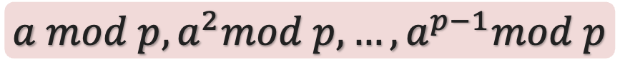
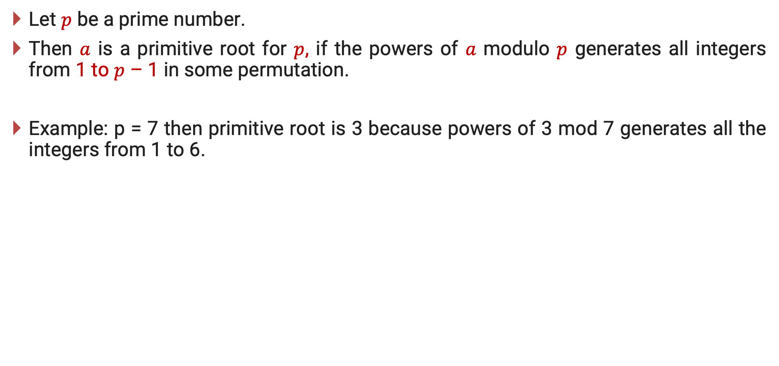
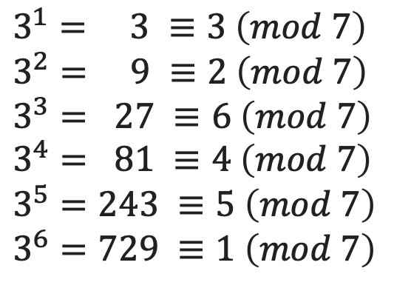
Primitive root
Let $p$ be a prime number.
Then $a$ is a primitive root for $p$, if the powers of $a$ modulo $p$ generates all integers from 1 to $p$ – 1 in some permutation.
Example: p = 7 then primitive root is 3 because powers of 3 mod 7 generates all the integers from 1 to 6.
$$a mod p, a^{2}mod p, …, a^{p−1}mod p$$
$$3^{1}= 3 ≡3 \left(mod 7\right)$$
$$3^{2}= 9 ≡2 \left(mod 7\right)$$
$$3^{3}= 27 ≡6 \left(mod 7\right)$$
$$3^{4}= 81 ≡4 \left(mod 7\right)$$
$$3^{5}=243 ≡5 \left(mod 7\right)$$
$$3^{6}=729 ≡1 \left(mod 7\right)$$

Slide 26
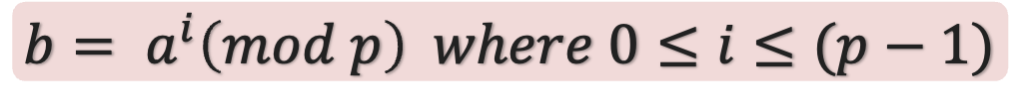
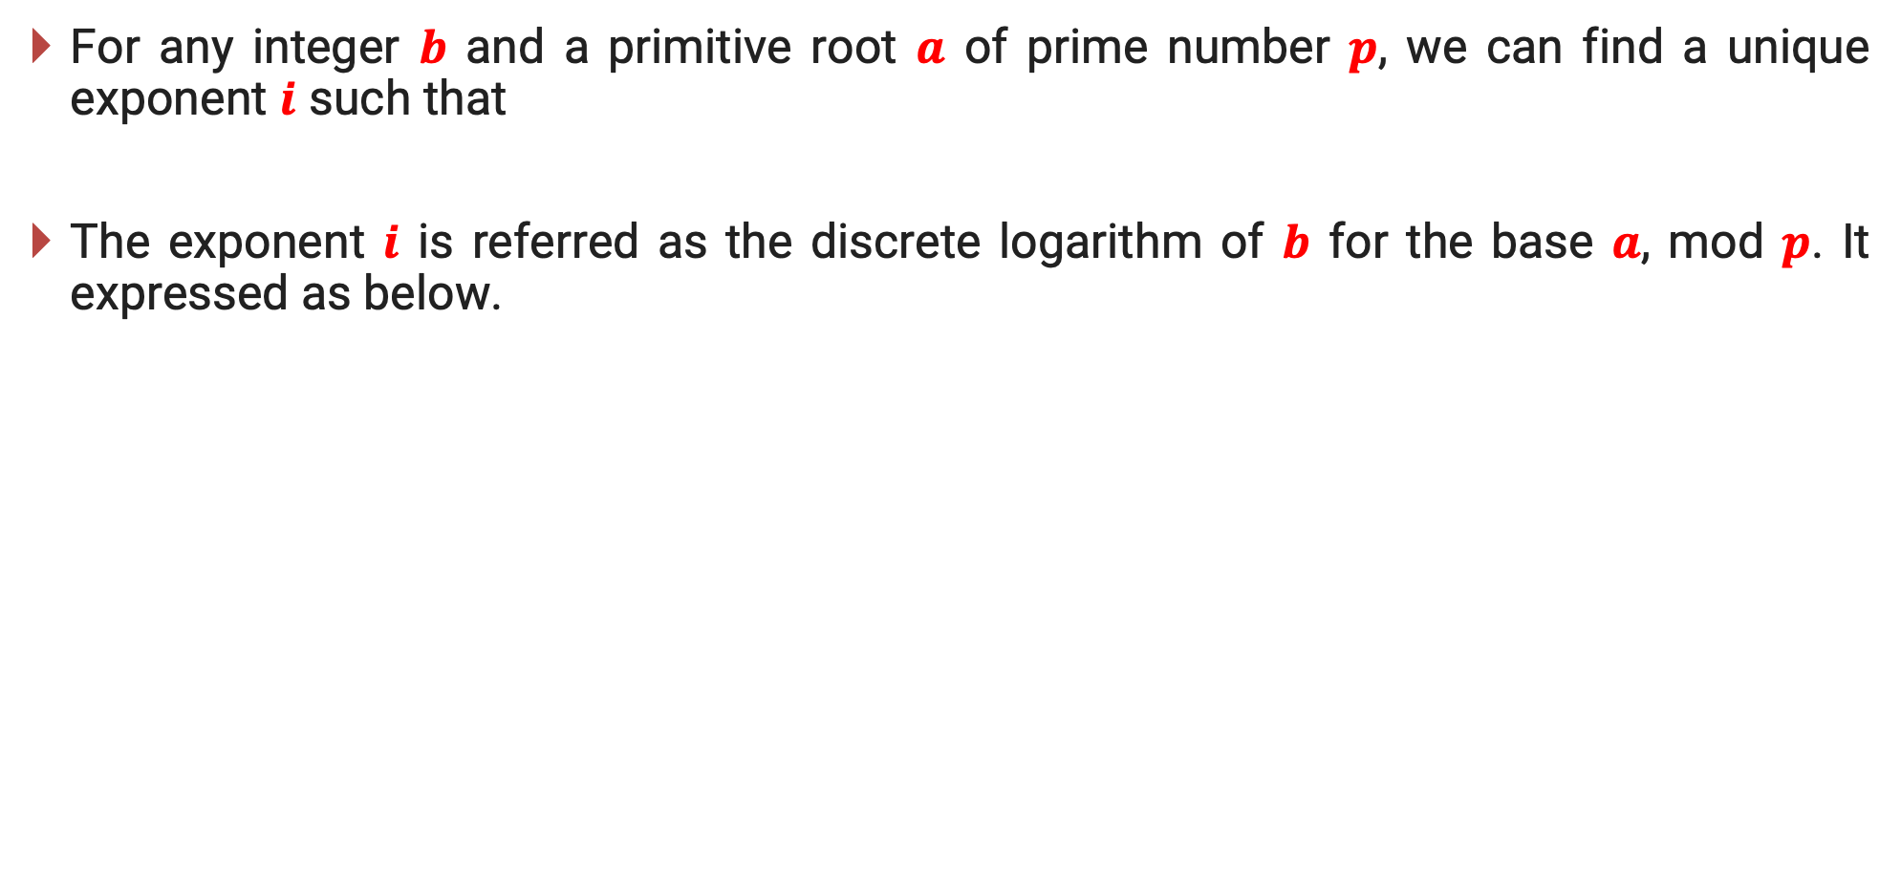
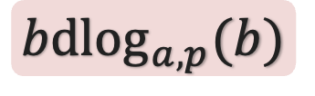
Discrete Logarithm
For any integer $b$ and a primitive root $a$ of prime number $p$, we can find a unique exponent $i$ such that
The exponent $i$ is referred as the discrete logarithm of $b$ for the base $a$, mod $p$. It expressed as below.
$$b= a^{i}\left(mod p\right) where 0≤i≤(p−1)$$
$$bd\log_{a,p}(b)$$

Slide 27
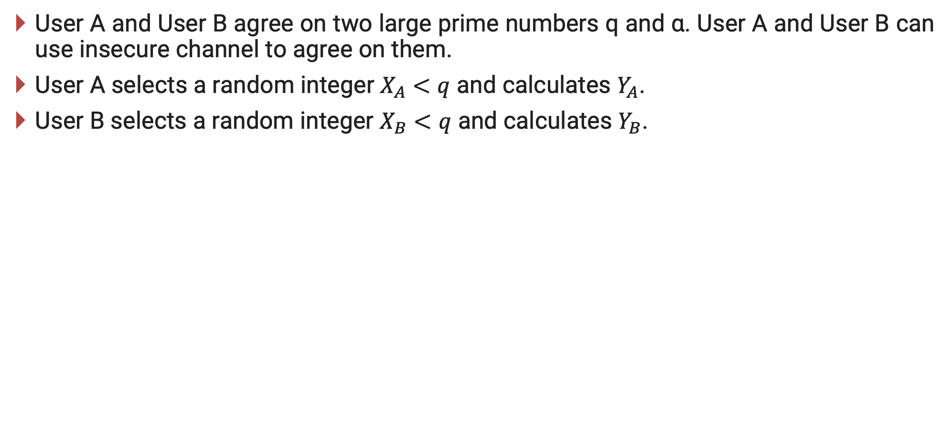
Diffie-Hellman Key Exchange – Cont…
User A and User B agree on two large prime numbers q and α. User A and User B can use insecure channel to agree on them.
User A selects a random integer $X_{A}<q$ and calculates $Y_{A}$.
User B selects a random integer $X_{B}<q$ and calculates $Y_{B}$.

Slide 28
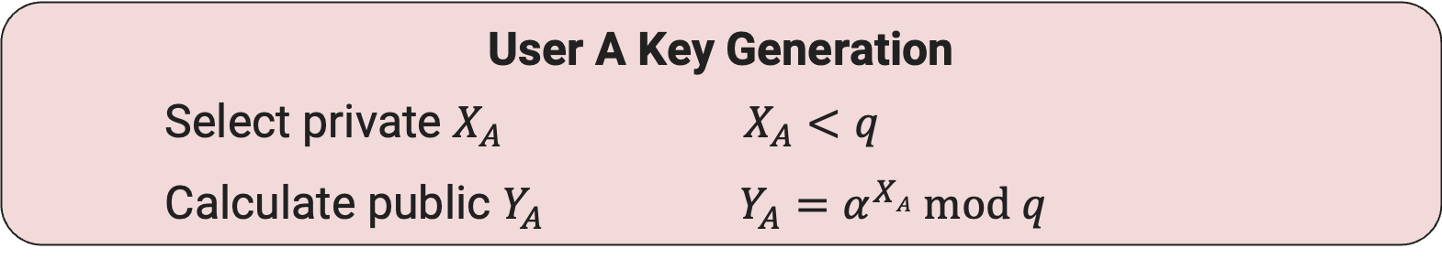
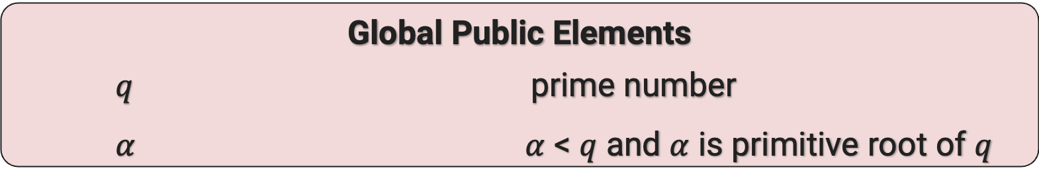
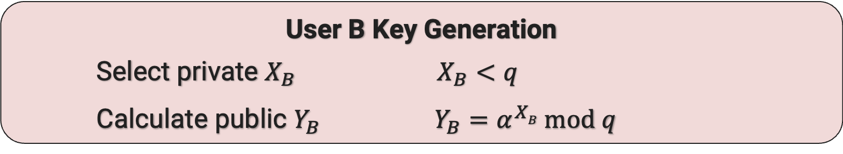
Diffie-Hellman Key Exchange – Cont…
Global Public Elements
$q$ prime number
$α$ $α$ < $q$ and $α$ is primitive root of $q$
User A Key Generation
Select private $X_{A}$ $X_{A}<q$
Calculate public $Y_{A}$ $Y_{A}=α^{XA} mod q$
User B Key Generation
Select private $X_{B}$ $X_{B}<q$
Calculate public $Y_{B}$ $Y_{B}=α^{XB} mod q$

Slide 29
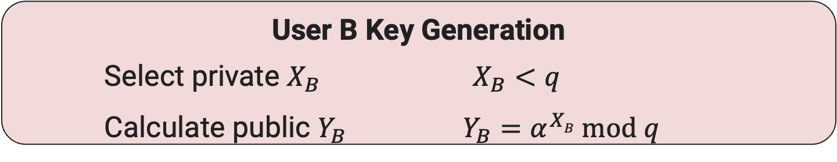
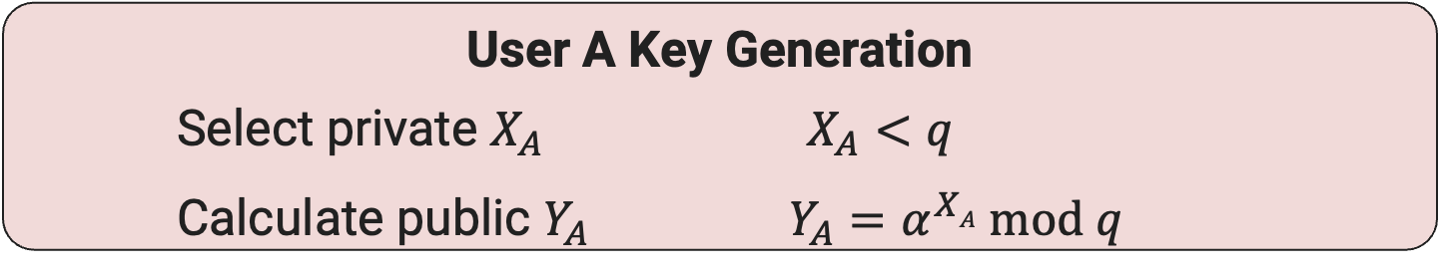
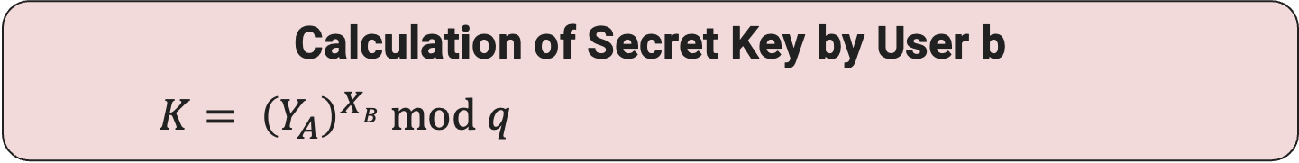
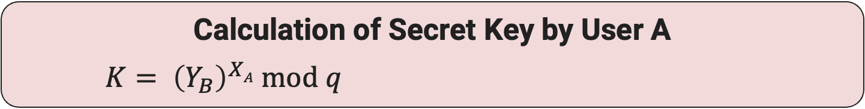
Diffie-Hellman Key Exchange – Cont…
User A Key Generation
Select private $X_{A}$ $X_{A}<q$
Calculate public $Y_{A}$ $Y_{A}=α^{XA} mod q$
User B Key Generation
Select private $X_{B}$ $X_{B}<q$
Calculate public $Y_{B}$ $Y_{B}=α^{XB} mod q$
Calculation of Secret Key by User A
$K= {\left(Y_{B}\right)}^{XA} mod q$
Calculation of Secret Key by User b
$K= {\left(Y_{A}\right)}^{XB} mod q$

Slide 30
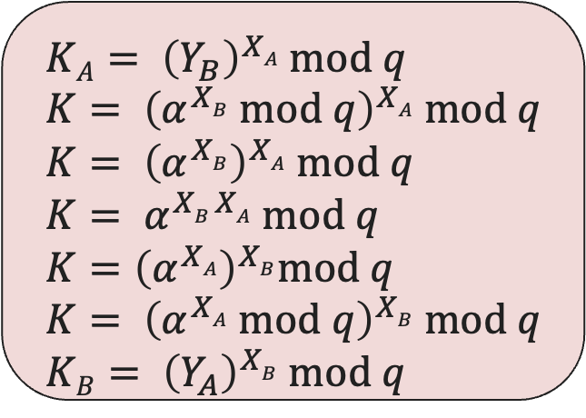
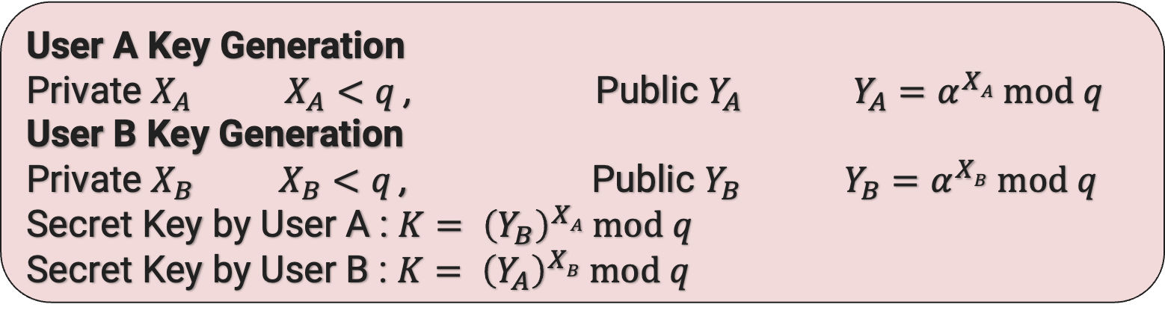
Diffie-Hellman Key Exchange – Cont…
User A Key Generation
Private $X_{A}$ $X_{A}<q$ , Public $Y_{A}$ $Y_{A}=α^{XA} mod q$
User B Key Generation
Private $X_{B}$ $X_{B}<q$ , Public $Y_{B}$ $Y_{B}=α^{XB} mod q$
Secret Key by User A : $K= {\left(Y_{B}\right)}^{XA} mod q$
Secret Key by User B : $K= {\left(Y_{A}\right)}^{XB} mod q$
$KA= {\left(Y_{B}\right)}^{XA} mod q$
$K= {\left(α^{XB} mod q\right)}^{XA} mod q$
$K= {\left(α^{XB}\right)}^{XA} mod q$
$K= α^{XB XA} mod q$
$K={\left(α^{XA}\right)}^{XB}mod q$
$K= {\left(α^{XA} mod q\right)}^{XB} mod q$
$KB= {\left(Y_{A}\right)}^{XB} mod q$

Slide 31
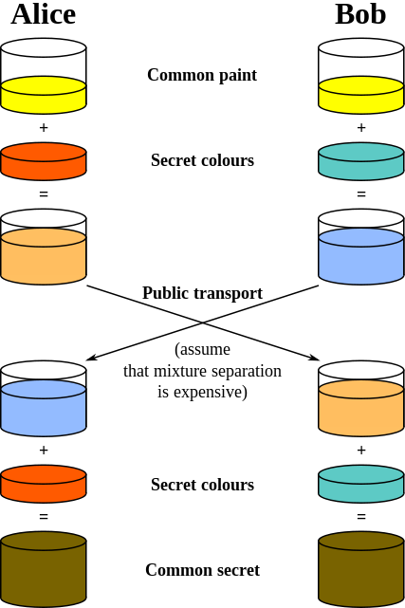

Slide 32
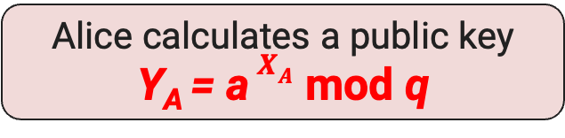
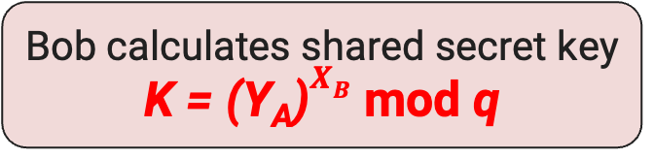
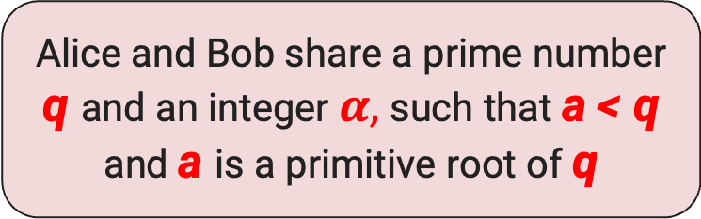
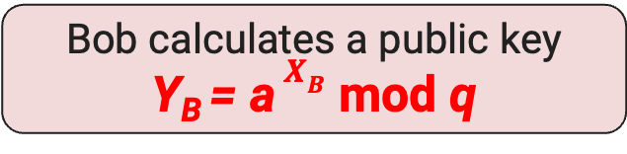
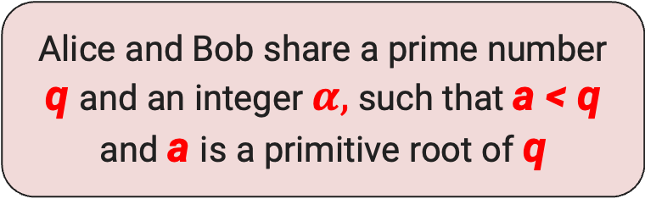
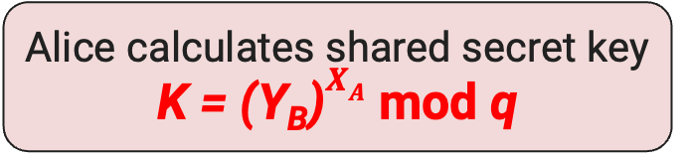
Diffie-Hellman Key Exchange Illustration
Alice
Bob
Alice and Bob share a prime number q and an integer $α,$ such that a < q and a is a primitive root of q
Alice and Bob share a prime number q and an integer $α,$ such that a < q and a is a primitive root of q
Alice generates a private key X_{A} such that X_{A} < q
Bob generates a private key X_{B} such that X_{B} < q
Alice calculates a public key
Y_{A} = a $X_{A}$ mod q
Y_{A}
Y_{B}
Bob calculates a public key
Y_{B} = a $X_{B}$ mod q
Alice receives Bob’s public key Y_{B} in plaintext
Bob receives Alice’s public key Y_{A} in plaintext
Alice calculates shared secret key
K = (Y_{B})$X_{A}$ mod q
Bob calculates shared secret key
K = (Y_{A})$X_{B}$ mod q

Slide 33
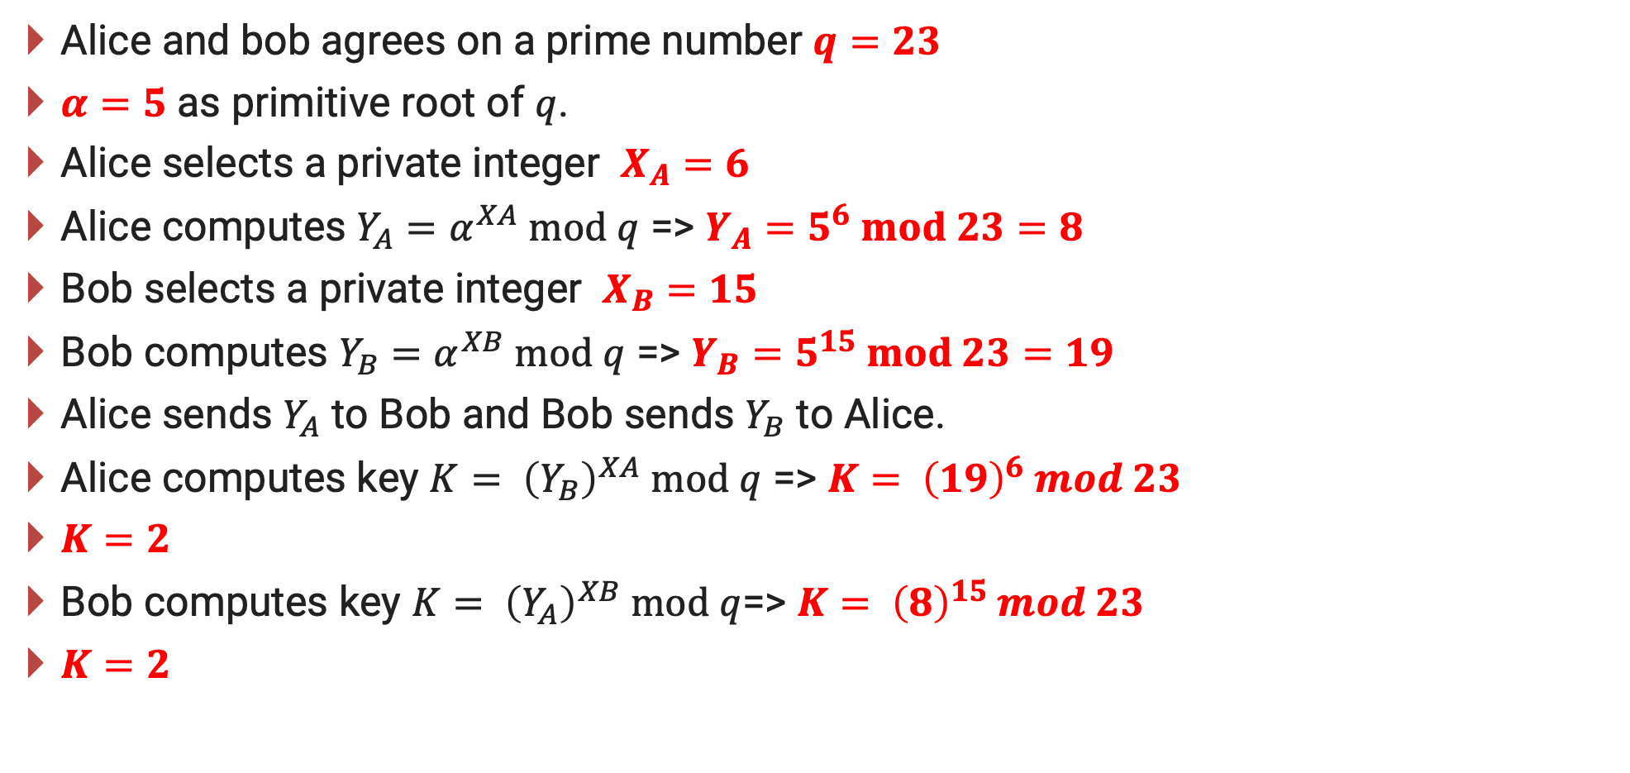
Diffie-Hellman Key Exchange Example
Alice and bob agrees on a prime number $q=23$
$α=5$ as primitive root of $q$.
Alice selects a private integer $X_{A}=6$
Alice computes $Y_{A}=α^{XA} mod q$ => $Y_{A}=5^{6} mod 23=8$
Bob selects a private integer $X_{B}=15$
Bob computes $Y_{B}=α^{XB} mod q$ => $Y_{B}=5^{15} mod 23=19$
Alice sends $Y_{A}$ to Bob and Bob sends $Y_{B}$ to Alice.
Alice computes key $K= {\left(Y_{B}\right)}^{XA} mod q$ => $K= {\left(19\right)}^{6} mod 23$
$K=2$
Bob computes key $K= {\left(Y_{A}\right)}^{XB} mod q$=> $K= {\left(8\right)}^{15} mod 23$
$K=2$

Slide 34
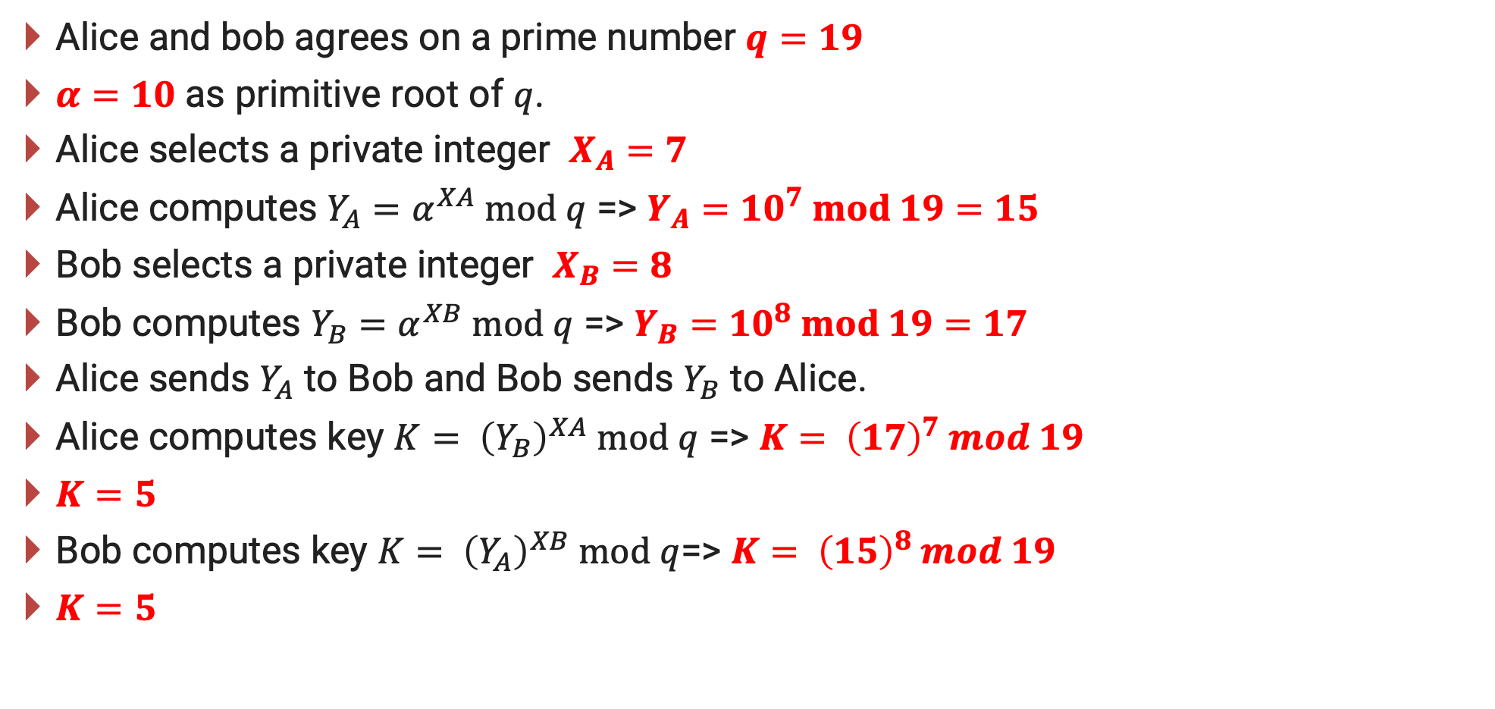
Diffie-Hellman Key Exchange Example
Alice and bob agrees on a prime number $q=19$
$α=10$ as primitive root of $q$.
Alice selects a private integer $X_{A}=7$
Alice computes $Y_{A}=α^{XA} mod q$ => $Y_{A}={10}^{7} mod 19=15$
Bob selects a private integer $X_{B}=8$
Bob computes $Y_{B}=α^{XB} mod q$ => $Y_{B}={10}^{8} mod 19=17$
Alice sends $Y_{A}$ to Bob and Bob sends $Y_{B}$ to Alice.
Alice computes key $K= {\left(Y_{B}\right)}^{XA} mod q$ => $K= {\left(17\right)}^{7} mod 19$
$K=5$
Bob computes key $K= {\left(Y_{A}\right)}^{XB} mod q$=> $K= {\left(15\right)}^{8} mod 19$
$K=5$

Slide 35
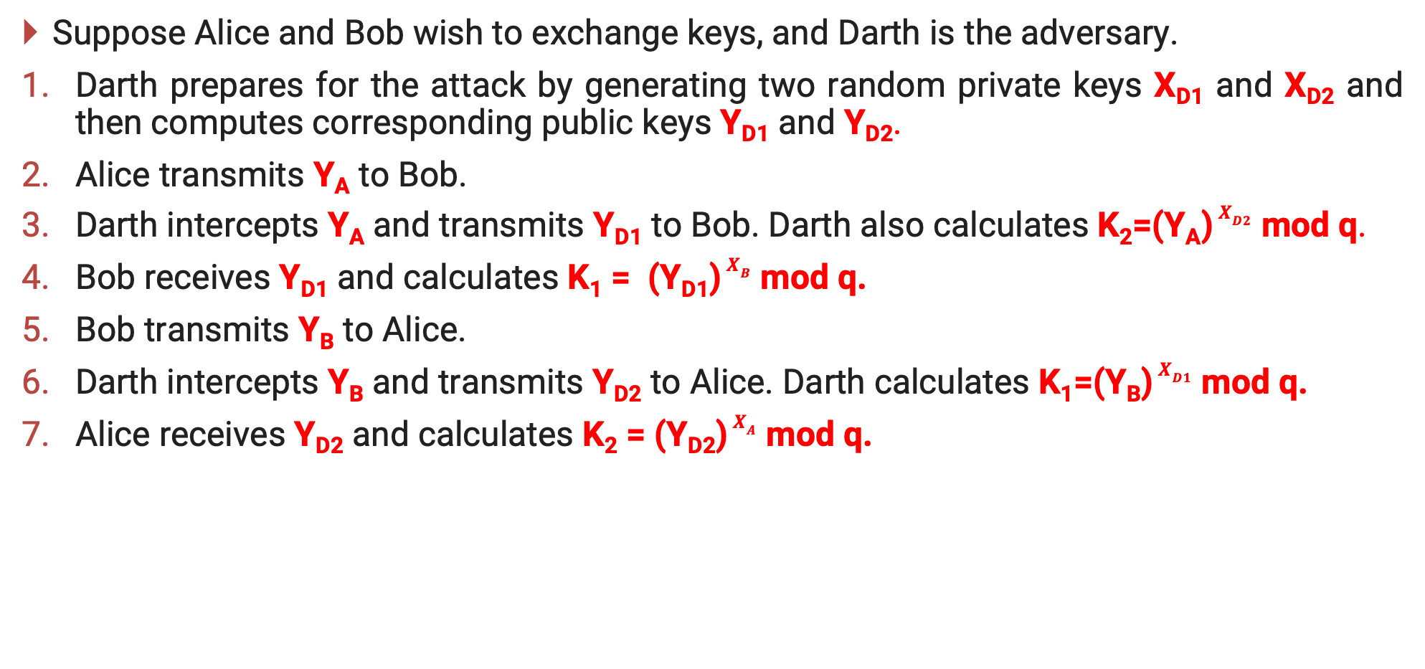
Man in the middle attack
Suppose Alice and Bob wish to exchange keys, and Darth is the adversary.
Darth prepares for the attack by generating two random private keys X_{D1} and X_{D2} and then computes corresponding public keys Y_{D1} and Y_{D2}.
Alice transmits Y_{A} to Bob.
Darth intercepts Y_{A} and transmits Y_{D1} to Bob. Darth also calculates K₂=(Y_{A}) $X_{D2}$ mod q.
Bob receives Y_{D1} and calculates K₁ = (Y_{D1}) $X_{B}$ mod q.
Bob transmits Y_{B} to Alice.
Darth intercepts Y_{B} and transmits Y_{D2} to Alice. Darth calculates K₁=(Y_{B}) $X_{D1}$ mod q.
Alice receives Y_{D2} and calculates K₂ = (Y_{D2}) $X_{A}$ mod q.

Slide 36
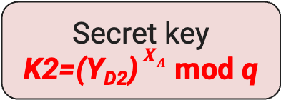
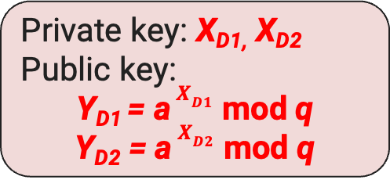
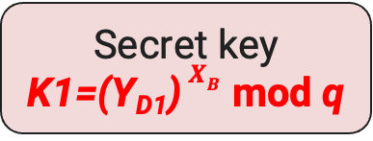
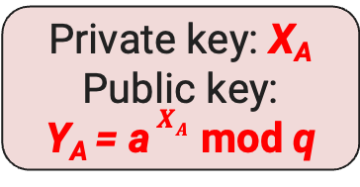
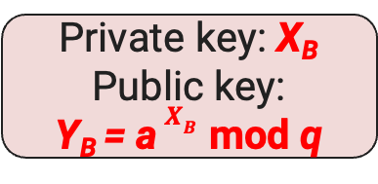
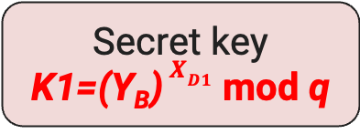
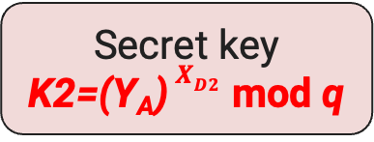
Alice | Darth | Bob
Private key: X_{A}
Public key:
Y_{A} = a $X_{A}$ mod q
Private key: X_{B}
Public key:
Y_{B} = a $X_{B}$ mod q
Y_{A}
Y_{B}
Private key: X_{D1,} X_{D2} Public key:
Y_{D1} = a $X_{D1}$ mod q
Y_{D2} = a $X_{D2}$ mod q
Y_{D2}
Y_{D1}
Secret key
K2=(Y_{D2}) $X_{A}$ mod q
Secret key
K2=(Y_{A}) $X_{D2}$ mod q
Secret key
K1=(Y_{D1}) $X_{B}$ mod q
Secret key
K1=(Y_{B}) $X_{D1}$ mod q
Alice and Darth
share Key K2
Darth and Bob
share Key K1

Slide 37
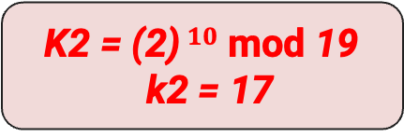
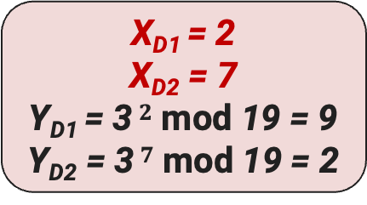
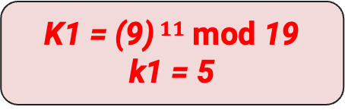
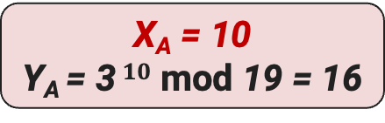
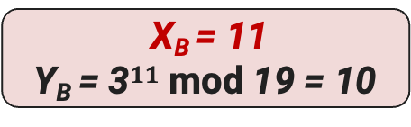
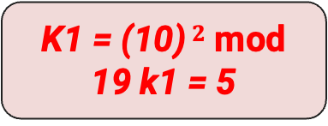
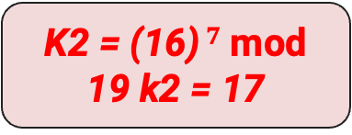
Alice | Darth | Bob
q = 19 and a = 3
q = 19 and a = 3
X_{A} = 10
Y_{A} = 3 $10$ mod 19 = 16
X_{B} = 11
Y_{B} = 3$11$ mod 19 = 10
Y_{A} = 16
Y_{B} = 10
X_{D1} = 2
X_{D2} = 7
Y_{D1} = 3 $2$ mod 19 = 9
Y_{D2} = 3 $7$ mod 19 = 2
Y_{D2} = 2
Y_{D1} = 9
K2 = (2) $10$ mod 19
k2 = 17
K2 = (16) $7$ mod 19 k2 = 17
K1 = (9) $11$ mod 19
k1 = 5
K1 = (10) $2$ mod 19 k1 = 5
Alice and Darth
share Key K2 = 17
Darth and Bob
share Key K1 = 5

Slide 38
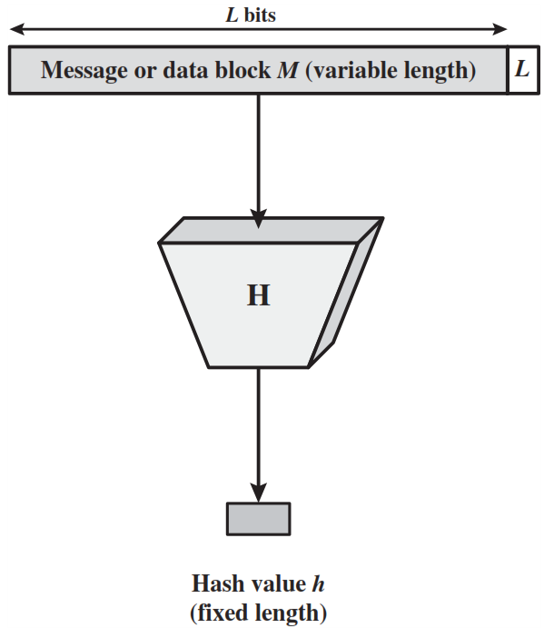
Hash Function
A hash function H accepts a variable-length block of data M as input and produces a fixed-size hash value h = H(M).
A “good” hash function has the property that the results of applying a change to any bit or bits in M results, with high probability, in a change to the hash code.

Slide 39
Input-Output behaviour of hash functions
Message digest
Message
Alice was beginning to get very tired of sitting by her sister on the bank, and have nothing to do.
H
DFDC349A
I am not a crook
H
FB93E283
I am not a cook
H
A3F4439B

Slide 40
Applications of Cryptographic Hash Functions
Message authentication
Digital Signature
One-way password file

Slide 41
1. Message Authentication
Message authentication is a mechanism or service used to verify the integrity of a message.
Message authentication assures that data received are exactly as sent (i.e., contain no modification, insertion, deletion, or replay).
When a hash function is used to provide message authentication, the hash function value is often referred to as a message digest.

Slide 42
Message authentication method - 1
Only A and B share the secret key, the message must have come from A and has not been altered.
The hash code provides the structure required to achieve authentication.
Because encryption is applied to the entire message plus hash code, confidentiality is also provided.
Source A
Destination B
M
M
H
ll
E
D
Compare
K
K
H
H(M)
E (K, [ M || H(M)])

Slide 43
Message authentication method - 2
Only the hash code is encrypted, using symmetric encryption.
This reduces the processing burden for those applications that do not require confidentiality.
Source A
Destination B
M
M
H
ll
K
K
Compare
H
E
D
E(K, H(M))

Slide 44
Message authentication method - 3
It is possible to use a hash function but no encryption for message authentication.
A and B share a common secret value S.
A computes the hash value over the concatenation of M and S and appends the resulting hash value to M. Because B possesses S, it can recompute the hash value to verify the message.
An opponent cannot modify an intercepted message.
Source A
Destination B
M
M
S
ll
H
ll
Compare
S
ll
H
H(M || S)

Slide 45
Message authentication method - 4
Confidentiality can be added to the approach of method (3) by encrypting the entire message plus the hash code.
Source A
Destination B
M
M
S
ll
H
ll
E
D
Compare
K
K
S
ll
H
H(M || S)
E (K, [ M || H(M || S)])

Slide 46
MAC (Message Authentication Code)
More commonly, message authentication is achieved using a MAC also known as keyed hash function.
MACs are used between two parties that share a secret key to authenticate information exchanged between those parties.
A MAC function takes as input a secret key and a data block and produces a hash value, referred to as the MAC.
The combination of hashing and encryption results in an overall function that is a MAC (Method -2 in previous slide).
MAC = C ( K , M )

Slide 47
Digital Signature
A digital signature is a mathematical technique used to validate the authenticity and integrity of a message, software or digital document.
The operation of the digital signature is similar to that of the MAC.
In the case of the digital signature, the hash value of a message is encrypted with a user’s private key.
Anyone who knows the user’s public key can verify the integrity of the message that is associated with the digital signature.

Slide 48
Requirements for hash functions
Can be applied to any length of message M.
Produces fixed-length output h.
It is easy to compute h=H(M) for any message M.
Given hash value h is infeasible to find y such that (H(y) = h)
One-way property (In other words, given a ﬁngerprint, we cannot derive a matching message).
For given block x, it is computationally infeasible to find
y ≠ x with H(y) = H(x)
Weak collision resistance
It is computationally infeasible to find messages m1 and m2 with H(m1) = H(m2)
Strong collision resistance

Slide 49
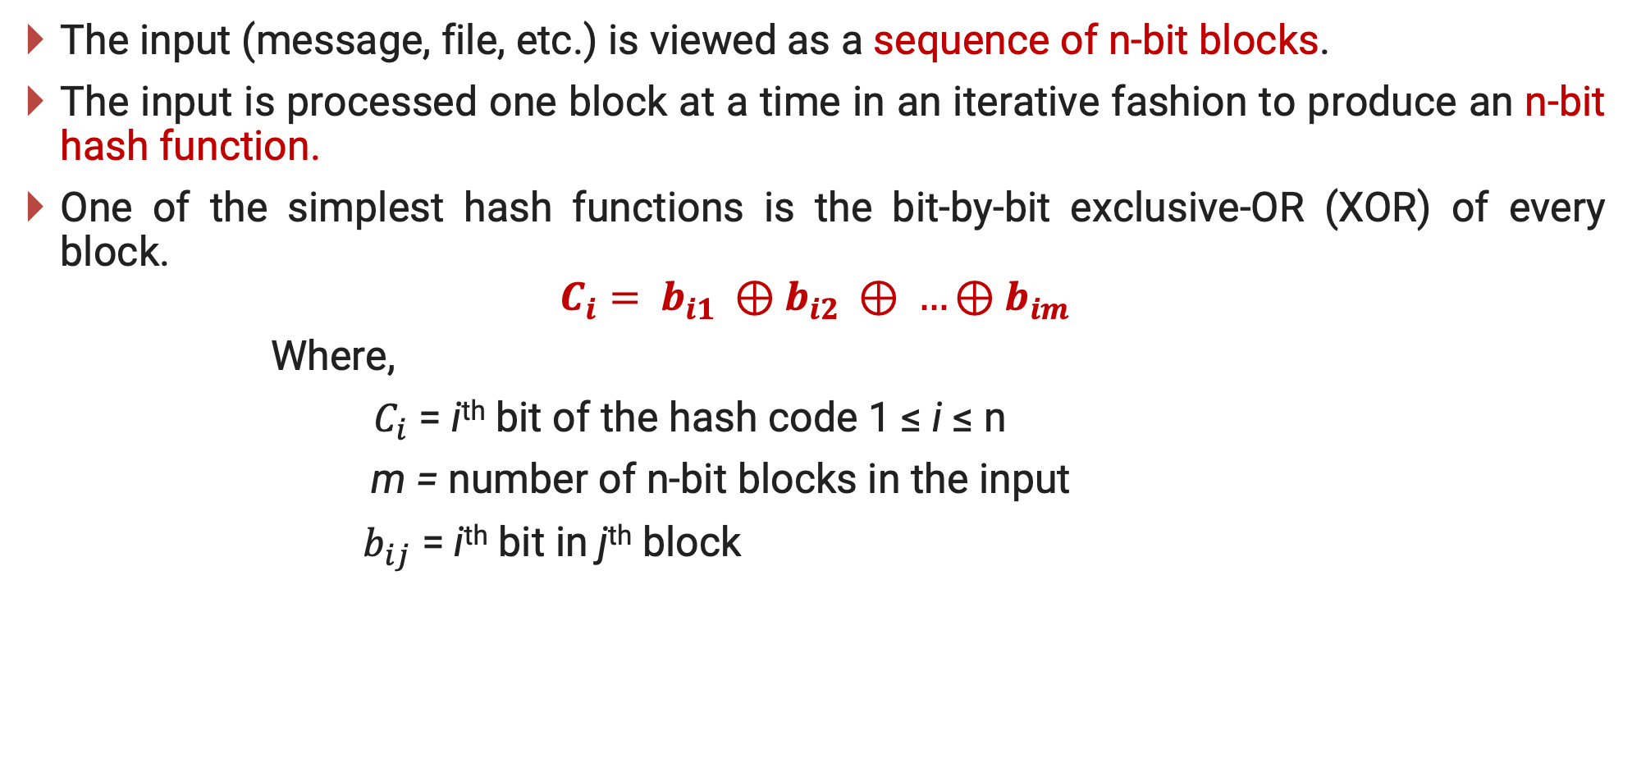
Simple Hash Function
The input (message, file, etc.) is viewed as a sequence of n-bit blocks.
The input is processed one block at a time in an iterative fashion to produce an n-bit hash function.
One of the simplest hash functions is the bit-by-bit exclusive-OR (XOR) of every block.
$$C_{i}= b_{i1} ⊕b_{i2} ⊕ …⊕b_{im}$$
Where,
$C_{i}$ = i^{th} bit of the hash code 1 ≤ i ≤ n
m = number of n-bit blocks in the input
$b_{ij}$ = i^{th} bit in j^{th} block

Slide 50
SHA - Secure Hash Algorithm
 | SHA - 1 | SHA - 224 | SHA - 256 | SHA - 384 | SHA - 512
Message Digest Size | 160 | 224 | 256 | 384 | 512
Message Size | < 2⁶⁴ | < 2⁶⁴ | < 2⁶⁴ | < 2¹²⁸ | < 2¹²⁸
Block Size | 512 | 512 | 512 | 1024 | 1024
Word Size | 32 | 32 | 32 | 64 | 64
Number of Steps | 80 | 64 | 64 | 80 | 80

Slide 51
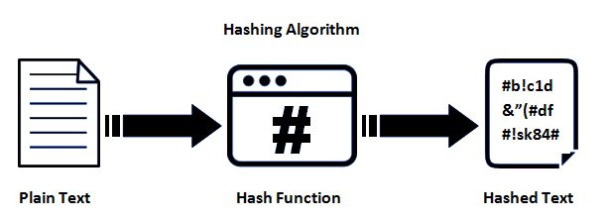
SHA-1 Algorithm
The Secure Hash Algorithm (SHA) was invented by the National Security Agency (NSA) and published in 1993 through the National Institute of Standard and Technology (NIST).
SHA depends on and shares the similar building blocks.
The design of SHA introduced a new process which develop the 16-word message block input to the compression function to an 80-word block between other things.
160 bits

Slide 52
Secure Hash Algorithm – SHA-1
M (m1,m2,m3,…,mn)
448 bits
Padding Process
160 bits
Compression Function
512 bits
Hash
160 bits

Slide 53
Step 1 − Append padding bits
First, we break our message into ’n’ number of parts (m₁, m₂, m₃, … m_{n}), each of size of 448 bits.
Then we add 64 bits of padding to each of them which converts their total length to 512 bits.
Padding includes a single 1 followed by the essential number of 0 bits.
These 512 bits are then put in the compression function along with the 160 bits of compressed output, for the first time we carry predefined value for the 160 bit value.
M (m1, m2, m3, …, mn)
448 bits
Padding Process
160 bits
Compression Function
512 bits
Hash
160 bits

Slide 54
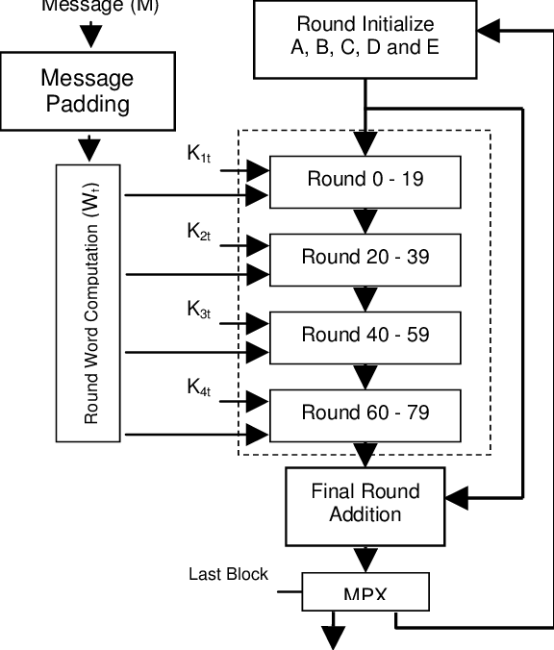
Step 2 − Compression Function
Message M
The compression function has a total of 80 rounds, these 80 rounds input with 512 bits each.
These 512 bits are further divided into 16 parts each of 32 bits and these are marked from W1 to W16.
The problem is that we have only 16 distinct parts of the message and 80 rounds of computation.
So, we repeat these 16 parts over and over for five times in the exact sequence they are in W1 to W16.
Continue
Up to last block
160 bits

Slide 55
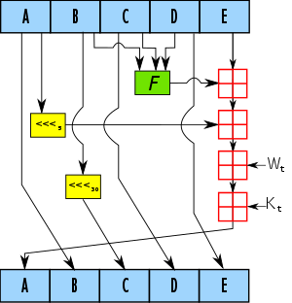
Step 3 −Initialize the buffer
we have 160 bits input, we break it down into 5 parts which we name to be A, B, C, D & E.
Rounds 1-20 f(1) = (B and C) or ((not B) and D) k(1) = 5A82 7999
Initial Value:
A = 6745 2301
B = ef cd ab89
C = 98ba dcfe
D = 1032 5476
E = c3d2 e1f0
Rounds 21-40 f(2) = B xor C xor D k(2) = 6ED9 EBA1
Rounds 41-60 f(3) = (B and C) or (B and D) or (C and D) k(3) = 8F1B BCDC
Single Round
Rounds 61-80 f(4) = B xor C xor D k(4) = CA62 C1D6

Slide 56
SHA - 512
The algorithm takes input as a message with a maximum length of less than 2¹²⁸ bits and produces output as a 512-bit message digest.
The input is processed in 1024-bit blocks.
SHA-512 does its work in a few stages. These stages go as follows:
Input formatting
Hash buffer initialization
Message Processing
Output
The entire formatted message has basically three parts:
This should all have a combined size of a whole multiple of 1024 bits.
This is because the formatted message will be processed as blocks of 1024 bits each.
original message
padding bits
size of original message

Slide 57




Original message, Padding bits, Size of original message

Slide 58
Message Digest Generation using SHA - 512
Message (L bit)
10000…0
L
M1 (1024 bits)
M2 (1024 bits)
MN (1024 bits)
F
F
F
+
+
+
IV=H0
H1 (512 bits)
H2 (512 bits)
HN (512 bits)

Slide 59
Step - 1 Append Padding Bits
The message is padded so that its length is congruent to 896 modulo 1024 [length ≡ 896(mod 1024)].
Padding is always added, even if the message is already of the desired length.
Thus, the number of padding bits is in the range of 1 to 1024.
The padding consists of a single 1 bit followed by the necessary number of 0 bits.

Slide 60
Step - 2 Append Length
A block of 128 bits is appended to the message.
This block is treated as an unsigned 128-bit integer (most significant byte first) and contains the length of the original message (before the padding).

Slide 61
Step-1 and Step-2 Example
Example:
Given is the message “abc” consisting of three 8-bit ASCII characters with a total length of l =24 bits.
We append a “1” followed by k = 871 zero bits, where k is determined by:
Finally, we append the 128-bit value which contains the binary representation of the length l = 24₁₀ =11000₂.
The padded message is then given by
A | B | C
01100001 | 01100010 | 01100011
k≡ 896−(l+1)=896−25=871 mod 1024
A | B | C | Append | Length
01100001 | 01100010 | 01100011 | 10000..0 | 00..011000

Slide 62

Step - 3 Initialize hash buffer
The outcome of the first two steps produces a message that is an integer multiple of 1024 bits in length.
The expanded message is represented as the sequence of 1024-bit blocks M₁ , M₂, … , M_{N}, so that the total length of expanded message is N X 1024 bits.
A 512-bit buffer is used to hold intermediate and final results of the hash function. The buffer can be represented as eight 64-bit registers (a, b, c, d, e, f, g, h).

Slide 63
Step - 4 Process message in 1024-bit (128-word) blocks
The heart of the algorithm is a module that consists of 80 rounds and this module is labelled as F function.

Slide 64
SHA - 512 Processing of a Single 1024-Bit Block
Mi
Hi-1
Message schedule
a
b
c
d
e
f
g
e
64
W0
K0
Round 0
a
b
c
d
e
f
g
e
64
W79
K79
Round 79
+
+
+
+
+
+
+
+
Hi

Slide 65
SHA - 512 Processing of a Single 1024-Bit Block
Each round takes as input the 512-bit buffer value, abcdefgh, and updates the contents of the buffer.
At input to first round, the buffer has the value of the intermediate hash value, H_{i-1}.
Each round t makes use of a 64-bit value W_{t}, derived from the current 1024-bit block being processed.
The output of the eightieth round is added to the input to the first round (H_{i}-1) to produce H_{i}.

Slide 66
Step – 5 Output
After all N^{th} block of 1024-bit have been processed, the output from the N^{th} stage is the 512-bit message digest.

Slide 67

SHA - 512 Round Function

Slide 68
SHA - 512 Round Function – Cont…
a
b
c
d
e
f
g
h
Ch
+
Ʃ
Maj
+
Ʃ
+
+
+
+
Wt
+
Kt
a
b
c
d
e
f
g
h

Slide 69





$$h=g$$
$$g=f$$
$$f=e$$
$$e=d+T_{1}$$
$$d=c$$
$$c=b$$
$$b=a$$
$$a=T_{1}+T_{2}$$
$$T_{1}=h+Ch\left(e,f,g\right)+\left(\sum_{1}^{512}{e}\right)+ W_{t}+K_{t}$$
$$T_{2}=\left(\sum_{0}^{512}{a}\right)+Maj\left(a,b,c\right)$$

Slide 70
SHA - 512 Round Function Elements
Maj(a,b,c) = (a AND b) XOR (b AND c) XOR (a AND c) Majority of arguments are true.
Conditional function = (e AND f) XOR (NOT e and g)
∑(a) = ROTR(a,28) XOR ROTR(a,34) XOR ROTR(a,39)
∑(e) = ROTR(e,14) XOR ROTR(e,18) XOR ROTR(e,41)
+ = addition modulo 2⁶⁴
K_{t} = a 64-bit additive constant.
W_{t} = a 64-bit word derived from plaintext.
ROTR = Circular right shift rotation

Slide 71
Information & Network Security (INS)
DU #2101CS622
Prof. Maulik D Trivedi
Computer Engineering Department
maulik.trivedi@darshan.ac.in
9998 265 805

